Slide 1
Lecture-1
People of Bangladesh

Slide 2
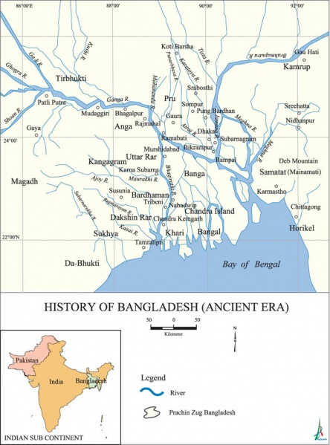
Map of ancient Bengal

Slide 3
Anthrophony
Definition of Anthropology
The word ‘Anthropology’ has been derived from two Greek words-
Anthrop means man &
Logia means study or science
Thus, the etymological meaning of Anthropology is “the study of man”.
C.A Kottak defines “Anthropology” as follows-
“The scientific and humanistic study of the human species. It is the exploration of human diversity in time and space.
Beals and weitz define as -
“The anthropologist combines in one discipline the approaches of both biological and the social sciences”.
Nanda Serena says-
“Anthropology is the comparative study of human kind.”

Slide 4
Types of Anthropology
Anthropology may be broadly divided into two areas-
Physical Anthropology
Cultural Anthropology
Physical Anthropology: Physical Anthropology mainly focuses on biological aspects of human being. Physical anthropology links to other fields: - Biology, Zoology, Geology, Physiology, Anatomy and Medicine.
Physical anthropology has several specialized areas. This are-
Evolutionary Biology: It discusses about human evolution. It can be divided into two types-
Paleontology- The study of the buried fossils of human and related animals.
Primatology- The study of the similarities and differences among the primates, namely, tree shrews, lemurs, and lorises, tarsiers- monkeys, apes and human.

Slide 5
Types of Anthropology
Human Biology: It is the study of human variation. It has several branches-such as: human genetics, skeletal biology & human adaptability.
Human Morphology: The scientific study of the form and structure of human body without consideration of function.
Anthropometry: Anthropometry is a comparative study of the human body. These techniques are used to measure the absolute and relative variability in size and shape of human body.

Slide 6
Cultural Anthropology
Cultural Anthropology is the study of human society and culture, the subfield that describes, analyzes interprets and explains social and cultural similarities and differences.
Cultural Anthropology may be subdivided into three main branches-
Ethnology
Archaeology
Linguistic
Ethnology: Ethnology is the scientific study and Comparison of human culture. Ethnology is concerned with patterns of thought and behavior such as: - marriage, customs, kinship, organization, political and economic systems, religion, folk art and music.
Archaeology: Archaeology is the study of past cultures. Anthropological archaeologists are usually concerned with what are called prehistoric cultures.

Slide 7
Linguistic: The transmission of culture from generation to generation is made possible by language, which enables us to preserve the traditions of the past and to make provisions for the future.
In anthropological approach, linguistics can be divided into several types—
Descriptive or Structural linguistics– deals with the characteristics sound unit employed in a language and its grammatical system.
Historical linguistics– deals with changes in language overtime, including sound shifts & the influence of one language on another.
Cognitive Anthropology– It is can concerned with the ways in which the speaker of a particular language classify and conceptualize phenomena.

Slide 8
Origin of the word Bengal or bangla
The exact origin of the word bengal or ‘bangla’ is unknown, though it is believed to be derived from the dravidian speaking tribe ‘bong’ that settled in this area. Ghulam hossain salim mentioned in his ‘riad-al-salatin’ that this tribe lived in this area on approximately 7500 years ago.
Other accounts speculate that the name is derived from vanga
( bonga),which came from the austric word ‘bonga’ means sun god.
According to mahabharat, purana,harivangsha vanga was the adopted son of the king vali who founded the vanga kingdom.
The muslim accounts refer teht ‘bong’ a son of king hind colonized the area first.

Slide 9
Origin of the word Bengal or bangla
Linguists believe that the name originated from the Tibetan word ‘bans’ which means wet and moist. Bangla is a wet country crisscrossed by a thousand rivers and monsoons and floods from the Himalayas.
Some other believe that the name originated from the assumes word ‘Bodo’ which means wide plains.
The earliest reference ‘vangala’ has been traced in the nesari plate (805A.D.) of dharmapala, the king of vangala.
Shams-ud-din iilyas shah took the title ‘shah-e-bangala’ and united the whole region under one government for the first time.

Slide 10
Peoples of Bengal Anthropological Background
It is very difficult to say with certainty when human settlement in bengal started. There are also controversy over the origin of the people of bangladesh.
The reconstruction of the history of Bengal in the pre-Muslim period is difficult due to paucity of sources. The difficulty is felt more acutely for the earlier period, down to the 4th century AD, when Bengal came under the Imperial Guptas. For this period we have to depend on very scanty references in the Vedic, Epic and Puranic literature as well as on the available archaeological evidence. From the Gupta period onwards we get written records in the form of epigraphs and literature which contain information on the history of the 'region' of Bengal.
Ghulam husain salim mentioned in his riyad al salatin that nearly seven thousand and five hundred years ago ‘bang’ tribe set up their residence in Bengal.

Slide 11
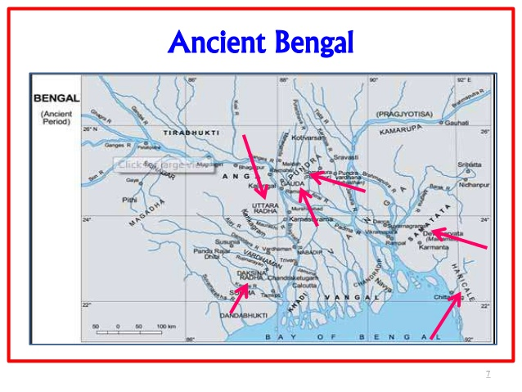

Slide 12
Peoples of Bengal Anthropological Background
The anthropological background of Bengali people rooted down in two distinctive groups(based on the ethnic language)-
Dravidians: Some scholars assume that people came and settled in Bengal (Bangladesh, West Bengal) ten thousand or more years ago. Those people were the non-Aryan ethnic groups – Nisadas or Austro-Asiatics or Austric who are now represented by the peoples known as Kola, Bhil, Santal, Shabara, Pulinda etc. Different groups of people settled in different areas in Bengal and the name of the areas were associated with the groups settled in that area. There were 16 ancient Janapadas, such as: Vanga, Pundra, Radha, Gauda, Harikela, Samatata, Magadha etc. These people altogether described as Dravidians.

Slide 13
Peoples of Bengal Anthropological Background
Aryans: It is very difficult to say about the time of arrival of Aryans and their expansion in Bengal, but it can be said that though the Aryans entered Indian sub-continent nearly three thousand five hundred years (1500B.C.),They came to Bangla very late, probably about 5th century B.C. The Aryans entered Bengal as fighters, traders and preachers of religion. As a result a new force was introduced in Bengal. The Aryan language, religion, social practices and other elements of culture was establish. The non Vedic language disappeared and the vedic, puranic religion, buddhism and jainism spread in Bengal. The extension of Gupta empire confirmed this process of the establishment of aryanism in Bengal.

Slide 14
Background of the People:
In order to know the anthropological background of the people of this soil, we have to analyze the ethnic or racial background of our people. So far Anthropologists have discovered four major races of mankind. They are as follows:
Caucasoid
Australoid
Skin color | White
Nose | Narrow and pointed
Lip | Thin
Stature and cephalic index | Extremely varied
Nordic, Alpine, Mediterranean, Europeans etc.
Skin color | Black
Hair | Thick and heavy
Brow ridge | Pronounced
Arms & Legs | Long and spindly
Aborigines of Australia

Slide 15
Mongoloid
Skin color | Brownish to yellow
Hair | Black and straight
Body Hair | Noticeably sparse
Nose | Flat
Chinese, Korean, Japanese etc.
Negroid
Skin color | Chocolate to jet black
Hair | Woolly or frizzy
Nose | Small
Ears | Bulbous
Lips | Bulbous
Jaw | Heavy
All Africans except North Africans and inhabitants of North Sahara.

Slide 16
Racial Characteristics of the people of Bangladesh
Proto-Australoid were the original inhabitants of Bangladesh.
The diversified Characteristics were seen among the Bengali Population.
They belonged to the Dravidian language speaking groups.
Stature | Short and middle structure
Size of the Skull | Long and round
Skin color | Black
Nose | Wide

Slide 17
There are Caucasoid, Mongoloid influence and Ausraloid influence on Bengali people,
therefore, the Bengalis are a mixed race.
During the period between 8th and 12th century, Muslim saints and Muslim traders came here from Turkey, Iran, and from other countries of central Asia. The Muslim saints came to preach Islam and the traders came with an ambition of trading here. Many of these people ultimately settled here permanently and also got married here. So, there is a great influence of the Muslims on the people of the Bengal.
According to Hunter, the Muslims of this country are converted Hindus and Buddha.
Finally, we can say that the original inhabitants of this country were by and Australoids influenced by Caucasoid and Mongoloid race. They did not belong to any major race of mankind but they were a mixed race.

Slide 18
Language:
Language and community are intimately linked. Bengal in the pre-Vedic period was supposed to be dominated by the people of Austric linguistic groups. This language is also known as Dravidian language. All their languages belonged to the language family of Austric. We may assume that Bengal in pre Aryan period had non Aryan speakers and there were a large number of Austro-Asiatic Mundary speakers, some of them are known as Munda, Santal, Ho, Bhumij, Mahali, Birhor, Turi and Kora at present. The word ‘Banga’ seems to be of Austro-Asiatic origin.
This was however replaced by Sanskrit language. Prakrit-Sanskrit language was greatly influenced by Austric language. Sanskrit borrowed many words and grammatical rules from Austric language. Many language of the present Indian subcontinent originated from sanskrit language. Almost all the languages of India and Bangladesh belong to the Sanskrit languages family. Bengali language had its origin in Sanskrit.

